Slide 1
MedAI Lowfi-Prototype
Presented by Phuc Hoang, Dinh Thuan, Adina

Slide 2
Problem vs. Solution
Problem
Solution
Users struggle to access reliable medical information, face complicated and inconvenient appointment scheduling, and lack a quick and easy way to get support for basic medical questions.
The app provides trustworthy medical information, 24/7 chatbot support for quick answers, and seamless online appointment scheduling to simplify healthcare access

Slide 3
Table of contents
01
03
02
04
Exploring Different Designs: Concept Sketches!
Low-Fidelity Prototype
+Testing Methodology
Selected Interface
Design & Rationale
Results &
Discussion

Slide 4
01
Concept Sketches

Slide 5
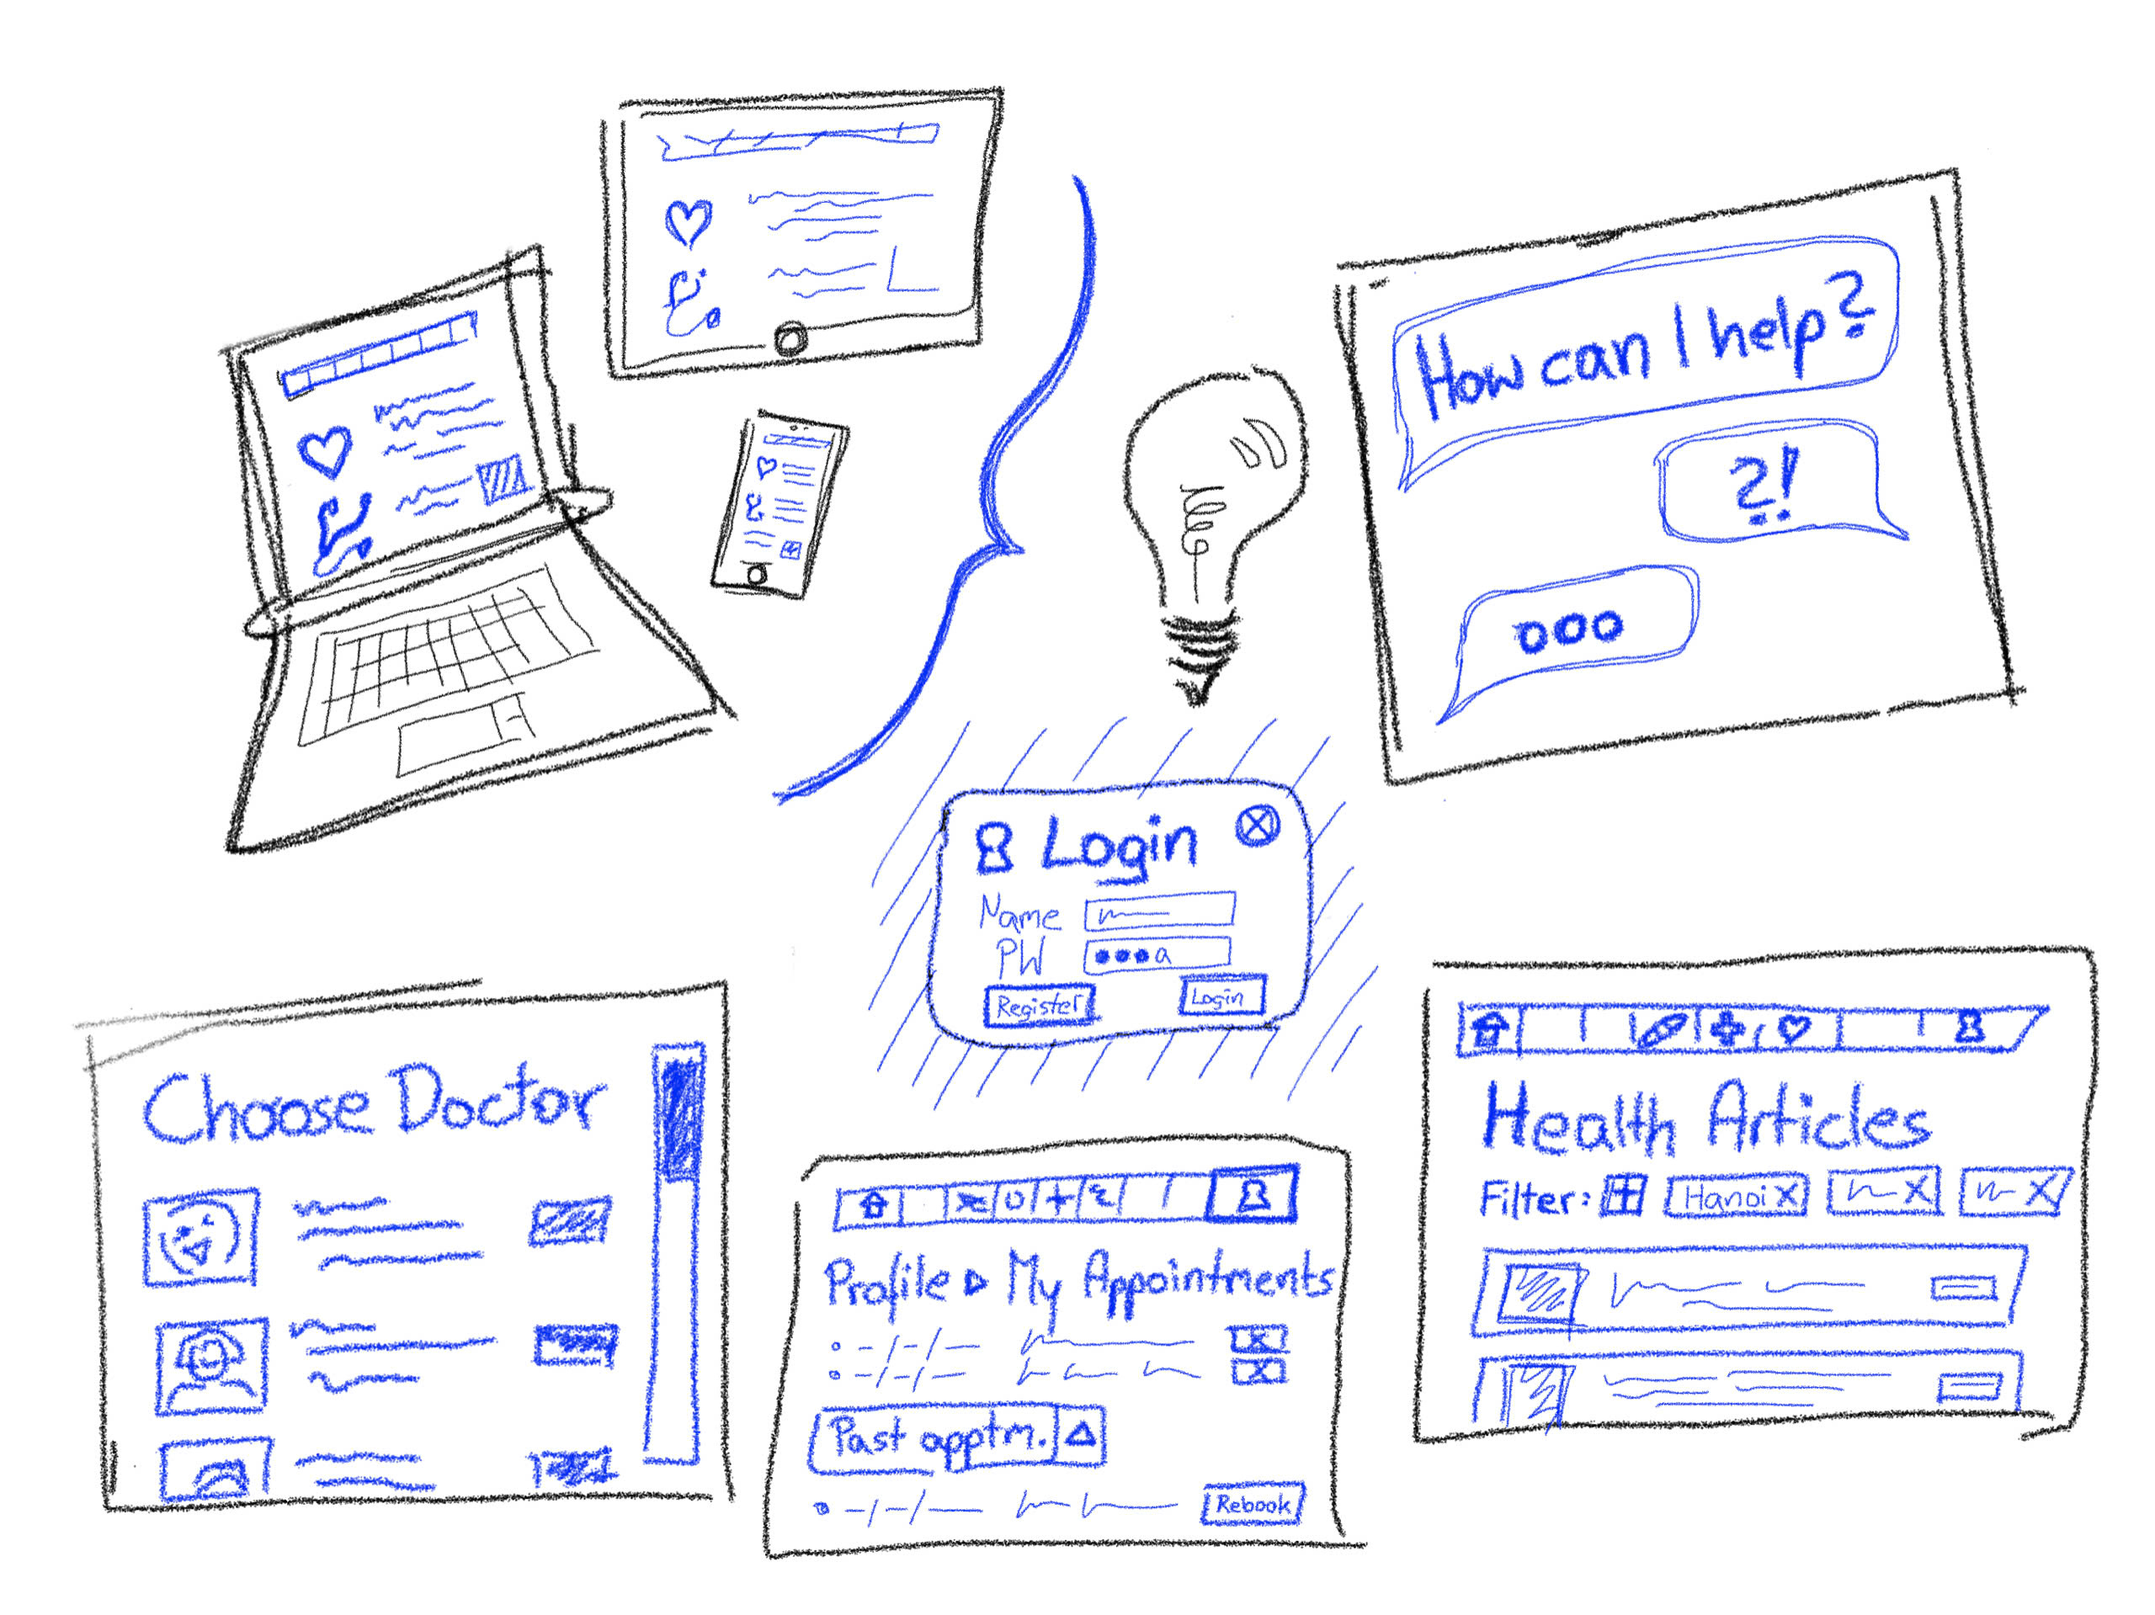
Concept 1: Website

Slide 6
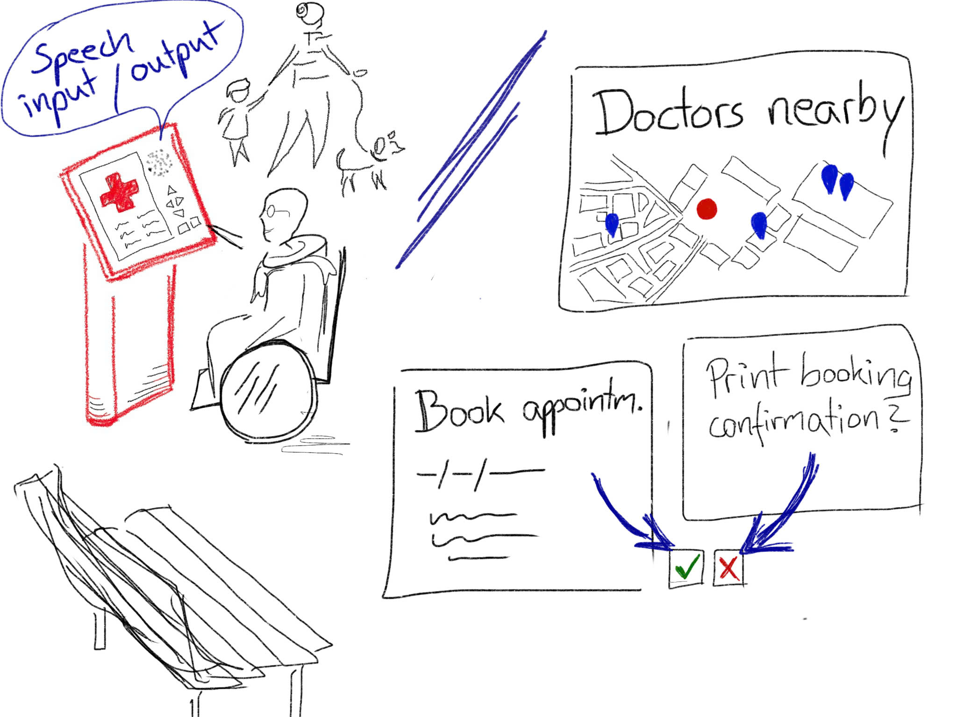
Concept 2: Public Kiosk

Slide 7
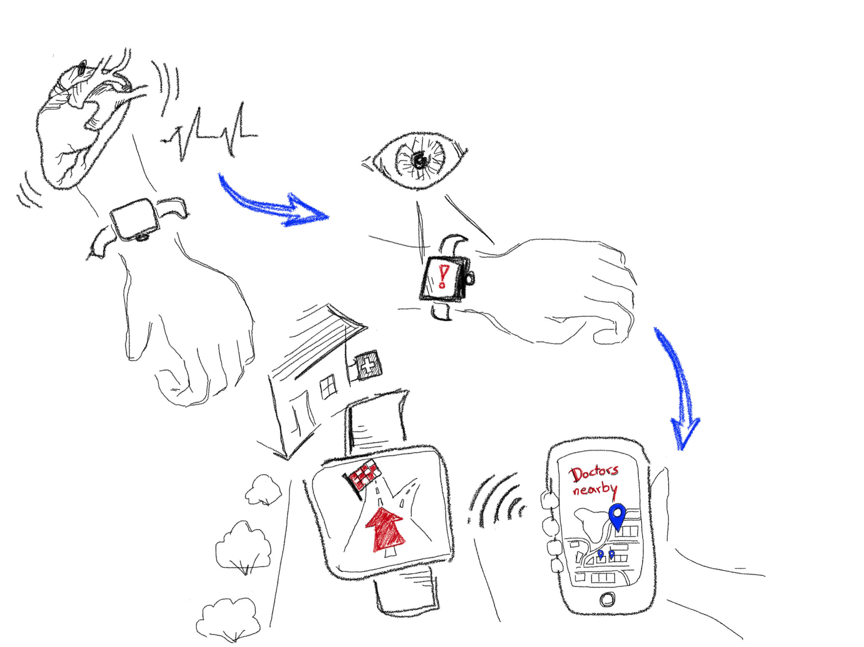
Concept 3: Interactive Wearables

Slide 8
Top 2 diverse realizations

Slide 9
Interactive wearables

Slide 10
Interactive wearables
Pros
Cons
Continuous monitoring: Provide real-time health data
Portability: Always with the user, making it easy for access data
Emergency alerts: Integration with emergency services
Personalized notifications: Reminders for medication, hydration, physical activity
Cost: Development, production, and purchase of wearables can be expensive
Limited Screen Size: The interface is small
Battery Dependency: Wearables require frequent charging
Learning Curve: Some users, especially older ones, might find wearables difficult to use or uncomfortable.

Slide 11
Interactive wearables

Slide 12
Medical website
Pros
Cons
Accessibility: Can be accessed from any device with an internet connection, making it widely available.
Comprehensive Information: Allows for detailed content like articles, visuals, videos
User-Friendly: Can be designed to suit users of all technical skill levels
Scalability: Can accommodate a broad user base and evolve with more features over time.
Passive Interaction: Unlike wearables, websites do not provide real-time health monitoring or alerts.
Dependence on Internet: Cannot function offline, limiting access for users
Lack of Immediate Feedback: Users don’t get real-time notifications or reminders.
Privacy Concerns: Potential vulnerability to data breaches and unauthorized access.

Slide 13
02
Selected Interface

Slide 14
Selected Interface: Website
While wearables offer real-time health tracking, their high cost, limited accessibility, and small interface make them less practical. A medical website is far more accessible, scalable, and user-friendly, reaching a wider audience with lower costs. It can host comprehensive features like appointment scheduling and health information, meeting diverse needs without requiring specialized devices.
Websites leverage the ubiquity of internet-connected devices, ensuring broad adoption and delivering impactful healthcare solutions.

Slide 15
03
Low-fidelity Prototype

Slide 16
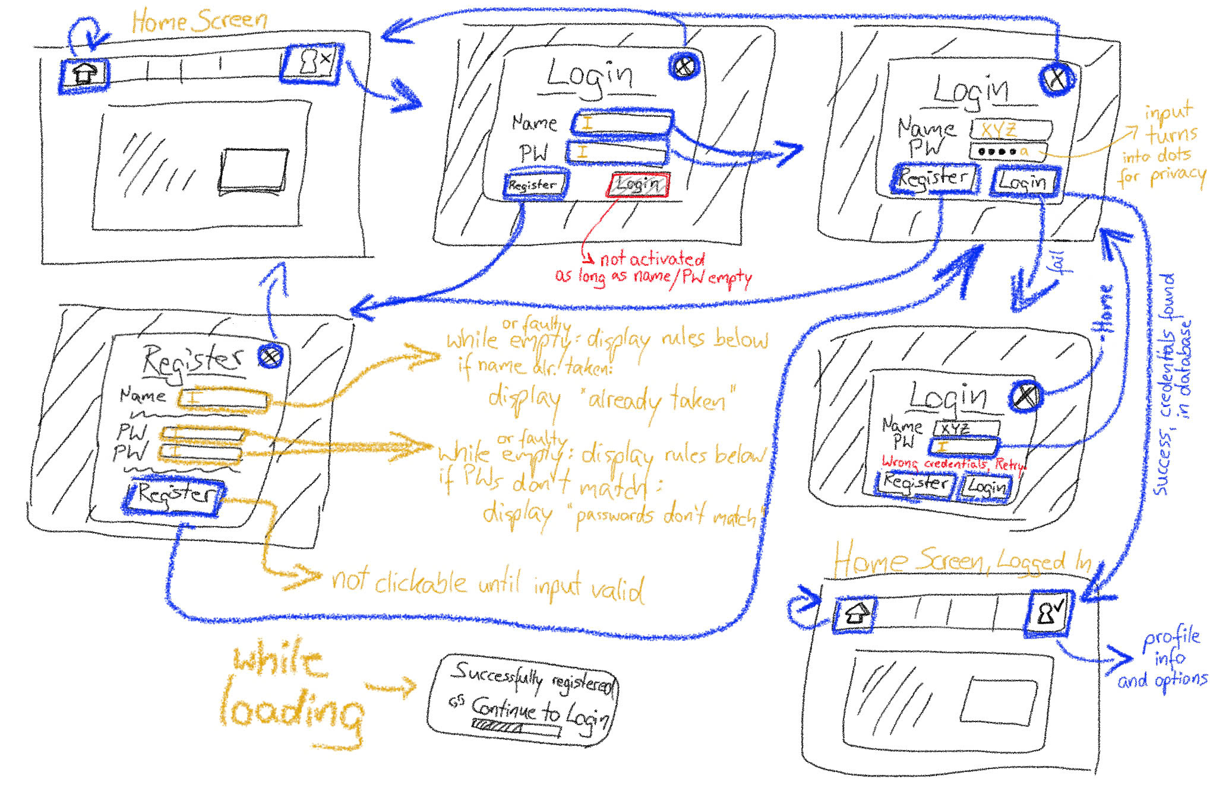
Home page, Login/Register page

Slide 17
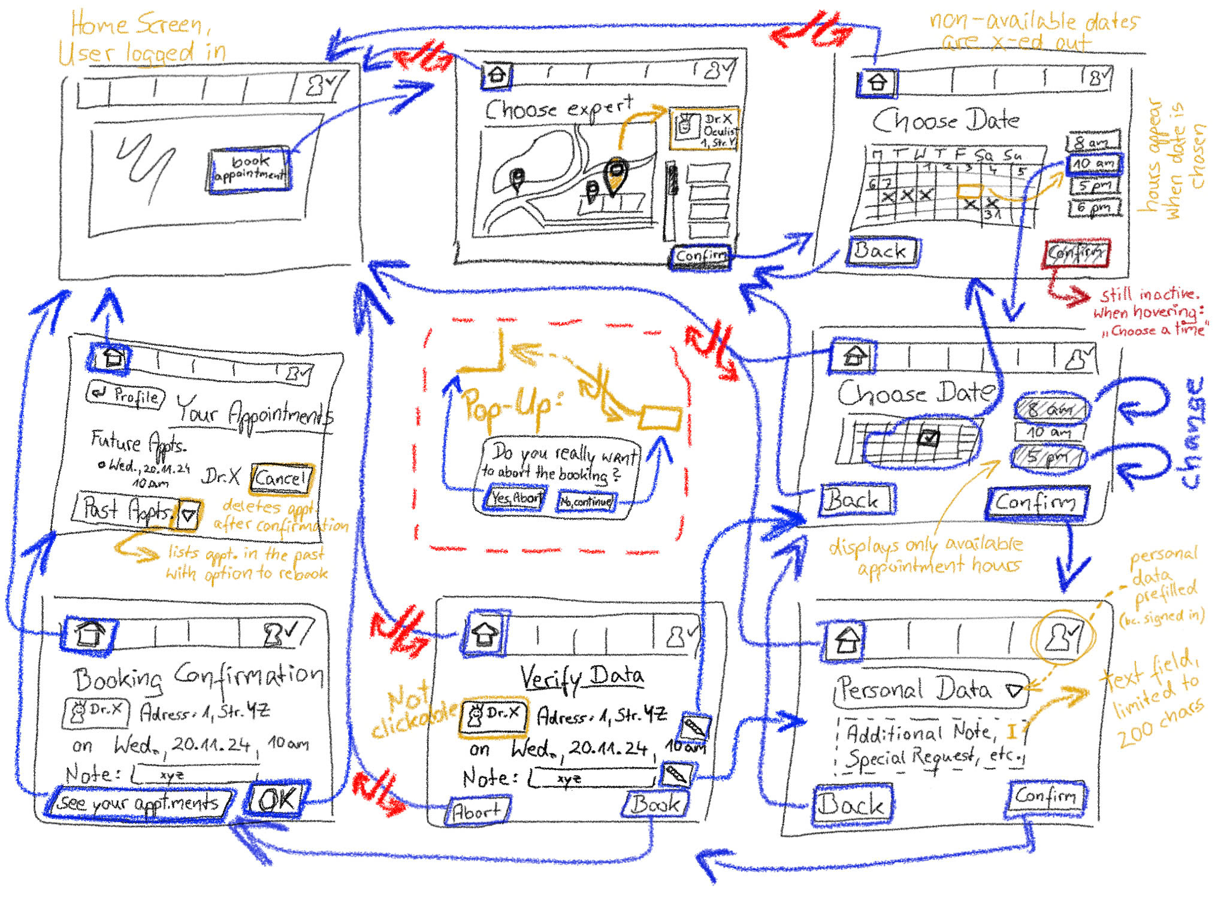
Home page, Appointment booking page

Slide 18
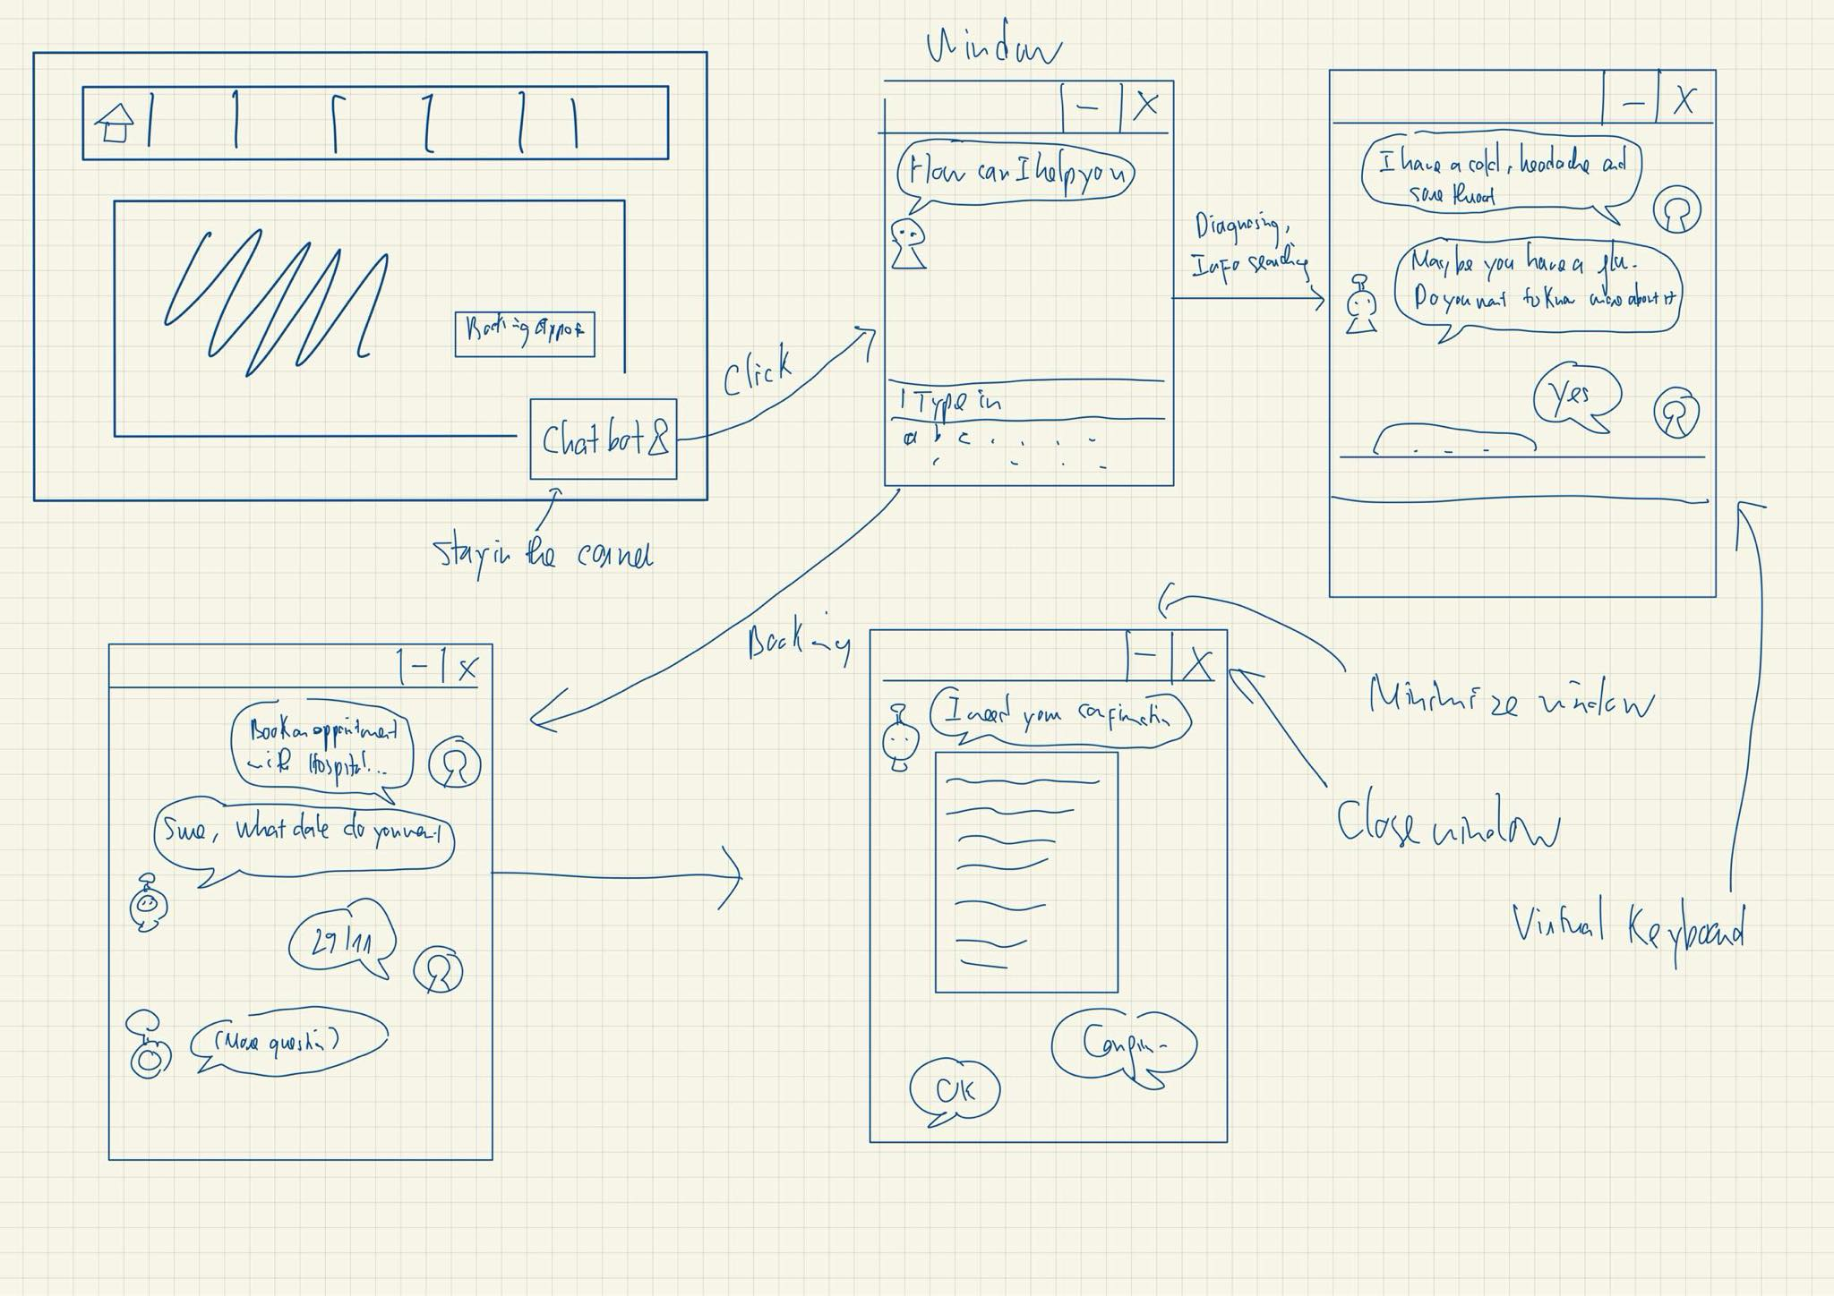
Homepage, Chatbot window

Slide 19
3 task flows
Moderate
Simple
Complex

Slide 20
Simple

Slide 21
Moderate

Slide 22
Complex

Slide 23
Testing Methodology

Slide 24



Our interviewees
N. P. Thanh (21)
P. M. Quan (52)
N. L. Na (25)
University student
Extreme user, never use website before
Freelancer

Slide 25
Procedure &Process!
We created a paper prototype and manually responded to user actions
Presented hypothetical scenarios to the user, then asked the users to perform the 3 tasks: Booking, Logging in, Chatbot interaction

Slide 26
Procedure &Process!
We took notes of the user behaviors
Participants were asked to think out loud what they do at each step
Participants are asked to give feedbacks about the flow of the prototype, about what they liked/didn’t like.

Slide 27
USABILITY GOALS & KEY MEASUREMENTS
Feature engagement: Use post-interaction surveys to assess user interest in key features (e.g., symptom checker, appointment scheduling) on a scale of 1-10 to gauge their likelihood of regular use.
Intuitive navigation: Track the number of navigation errors (e.g., misclicks or unintended page visits) users make while completing tasks such as booking an appointment or accessing health records.

Slide 28
04
Testing Results

Slide 29
Process Data
All 3 participants:
Found the appointment booking interface difficult to navigate.
Desired better integration with external calendars for scheduling.
Have no trouble interacting with the chatbot
2 participants:
Wanted the ability to customize their dashboard layout.
Want Third party Login, or F2P authentication
1 participant:
Got lost in the booking

Slide 30
Other observations
Task 1 (login): Caused a few "mis-clicks" due to unclear button labeling.
Task 2 (booking an appointment): Required the most time and multiple steps, indicating inefficiencies.
Task 3 (chatbot): Easy for users with minimal navigation effort.

Slide 31
Implications
Scheduling: Simplifying appointment booking and adding calendar integration can reduce confusion.
Login: Offering alternative login methods increases accessibility.
Filters: Users need intuitive interaction to get quick answers without frustration.

Slide 32
Changes
Streamline the appointment booking interface to reduce navigation errors.
Add visual cues (e.g., typing indicators or suggestions) to guide user input.
Enable multiple login options

Slide 33
Thanks!

